Slide 1

UNITED NATIONS GLOBAL GEODETIC
CENTRE OF EXCELLENCE
MODERNISING GEOSPATIAL REFERENCE SYSTEM
CAPACITY DEVELOPMENT WORKSHOP
Data registers and data sharing policies
Nicholas Brown
Head of Office, UN-GGCE
Day 2, Session 3 [2_3_3]
HOW
Acknowledgements: Michael Craymer (CAN); Roger Lott (IOGP); Liubov Poshyvailo-Strube (UN-GGCE); Scott Simmons (OGC).

Slide 2



Overview
Introduction
ISO geodetic registry
EPSG geodetic parameter dataset
OGC registry
Summary and conclusions
The image is created by Liubov Poshyvailo-Strube with Microsoft Designer, https://designer.microsoft.com/

Slide 3
Register and Registry
Register – A structured database of information with unique identifiers
Registry – A registry is an office (or perhaps a web site)
The need for geodetic registers and registries:
To unambiguously identify the different coordinate reference systems and transformations used to manage geospatial data – primarily in GIS software
To foster interoperability of geodetic data and products
To support the implementation of the UN-GGIM Global Geodetic Reference Frame (GGRF)
GGRF Implementation Plan recommends Member States to publish their reference system definitions and transformations in the “ISO Geodetic Registry and other such registries as required to facilitate sharing of data and the interoperability of data and products with the GGRF”¹
United Nations Committee of Experts on Global Geospatial Information Management: Road Map Implementation Plan, https://ggim.un.org/meetings/GGIM-committee/8th-Session/documents/Road-Map-Implementation-Plan.pdf. Accessed 28 January 2025.

Slide 4
OUTLINE
Introduction
ISO geodetic registry
EPSG geodetic parameter dataset
OGC registry
Summary and conclusions

Slide 5

https://geodetic.isotc211.org
ISO Geodetic Registry (ISOGR)
Maintained by the ISO Technical Committee on geographic information/ geomatics (ISO/TC 211)
Main purpose is to serve as the authoritative source for reference frames and transformation parameters
Information in the ISOGR has been either directly entered or approved by the agencies responsible for defining and maintaining the reference systems and transformations
Serves as an authoritative source for other registers (e.g., EPSG)
Not meant to compete with other registries but complement them

Slide 6
ISOGR Control Body
Control Body of geodetic experts reviews and approves information to be published on the ISOGR
ISOGR Control Body is chaired by IAG representatives
Chair: Michael Craymer
Vice-chair: Larry Hothem
ISOGR Control Body is composed of geodetic experts appointed by TC 211 members
28 members
13 countries
5 liaison organizations (IAG, FIG, PAIGH, OGC, CalConnect)
The Control Body meets monthly to review and approve the content for the ISOGR

Slide 7
ISOGR
Built on ISO standards
Main standards include
ISO 19111 “Referencing by coordinates”,
ISO 19127 “Geodetic register”
ISO 19135-1 “Procedures for item registration”
Other standards used for
Date, time and coordinate formats
Geography Markup Language (GML) output
Text representation output
. . .

Slide 8
Geodetic data registration
Proposal approval process
ISO 19127 and ISO 19135 define procedures for preparing, managing, and maintaining the ISOGR
Types of submissions (proposals)
Addition of new data
Clarification or correction of existing data
Supersession (i.e., updating) of existing data
Retirement of existing data (i.e., no longer used but retained for historical purposes)
Invalidation of existing erroneous data
For any questions: isogr@geodetic.org
Submitting organization prepares proposal in collaboration with Control Body
Submit proposal
Register Manager reviews proposal for completeness
Reject
Accept proposal
Control Body reviews proposal for correctness
Reject
Approve proposal
Add to Register

Slide 9
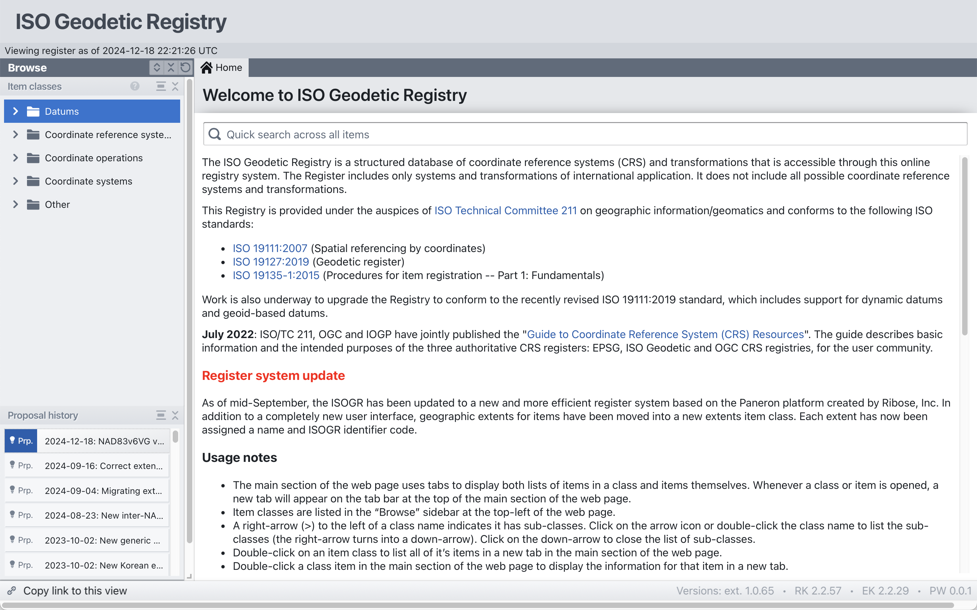




https://geodetic.isotc211.org
Developed by
With support from
Current Content
977 register items
98 reference frames
32 vertical datums
275 geodetic CRSs
32 vertical CRSs
122 conversions
395 transformations

Slide 10
ISOGR usage
Former ISOGR registry platform had
Over 10 000 users since public release in 2019
Over 10 000 page views per year
Usage increased significantly in 2023
Nearly half are now returning (regular) users
 | Users | Returning | Pageviews
Jun-Nov 2019 | 681 | 14% | 441
Dec-Jun 2020 | 890 | 13% | 6507
Jun-Nov 2020 | 964 | 15% | 11826
Dec-Jun 2021 | 1158 | 24% | 6932
Jun-Nov 2021 | 1412 | 14% | 4960
Dec-May 2022 | 889 | -37% | 2980
Jun-Dec 2022 | 1,128 | 27% | 4755
Dec-May 2023 | 895 | -20% | 5010
Jun-Dec 2023 | 1,300 | 45% | 6691
Registry migrated to a new platform in 2024
More efficient for operation in the AWS cloud
Will commence usage tracking again

Slide 11
EUREF content
https://www.euref.eu/
Global ITRF geodetic datums (14) and CRSs (42)
Regional ETRF geodetic datums (11) & CRSs (33)
Regional EVRF vertical datums (4) & CRSs (4)
ITRF–ETRF transformations (33)
Examples for ETRF2020 on following slides
ETRF2020 datum
ETRF2020 LatLonEHt CRS
ITRF2020 to ETRF2020 transformation

Slide 12
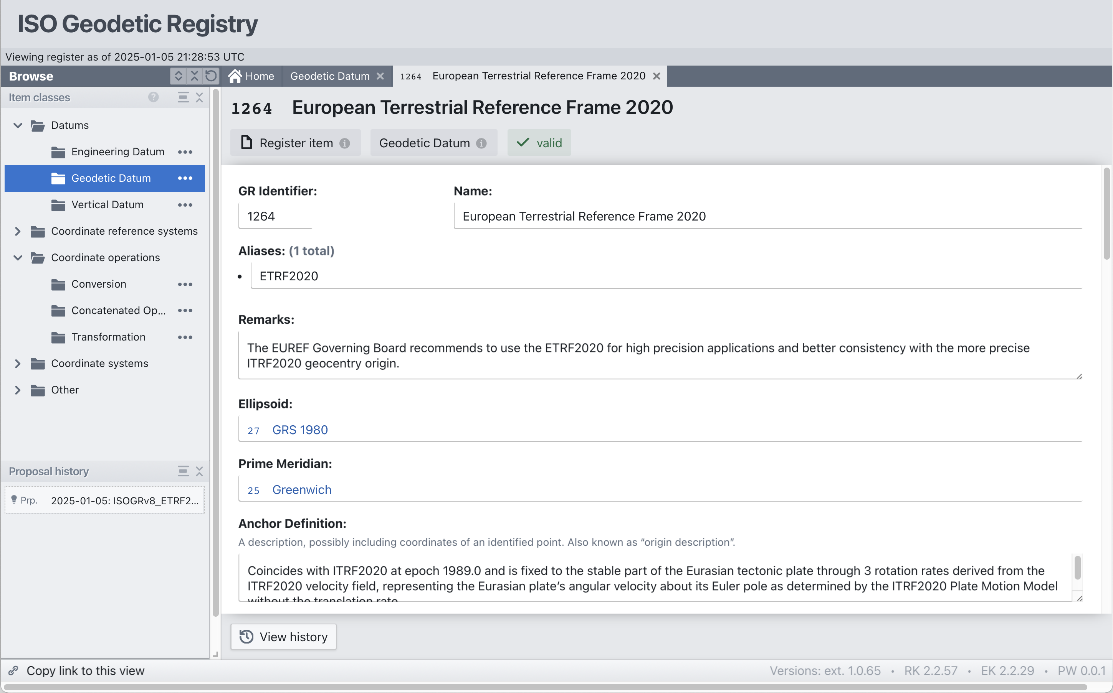

Slide 13
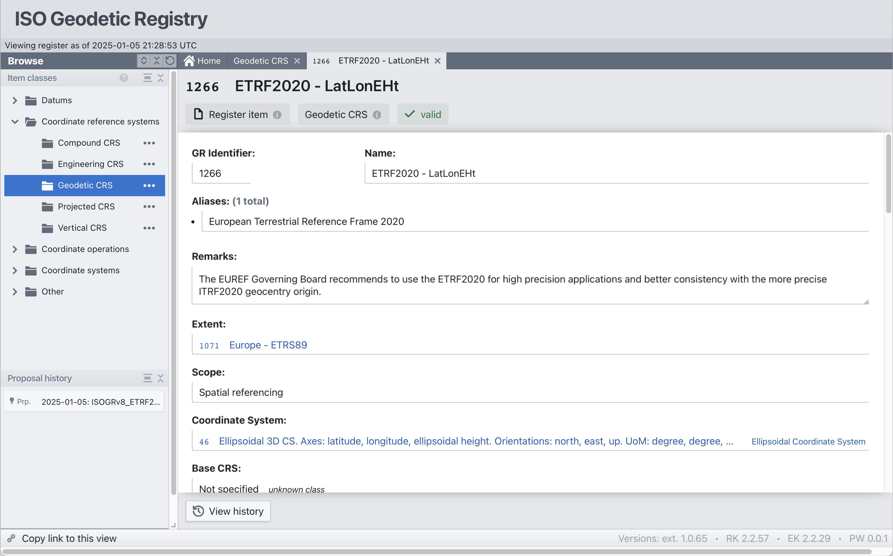

Slide 14
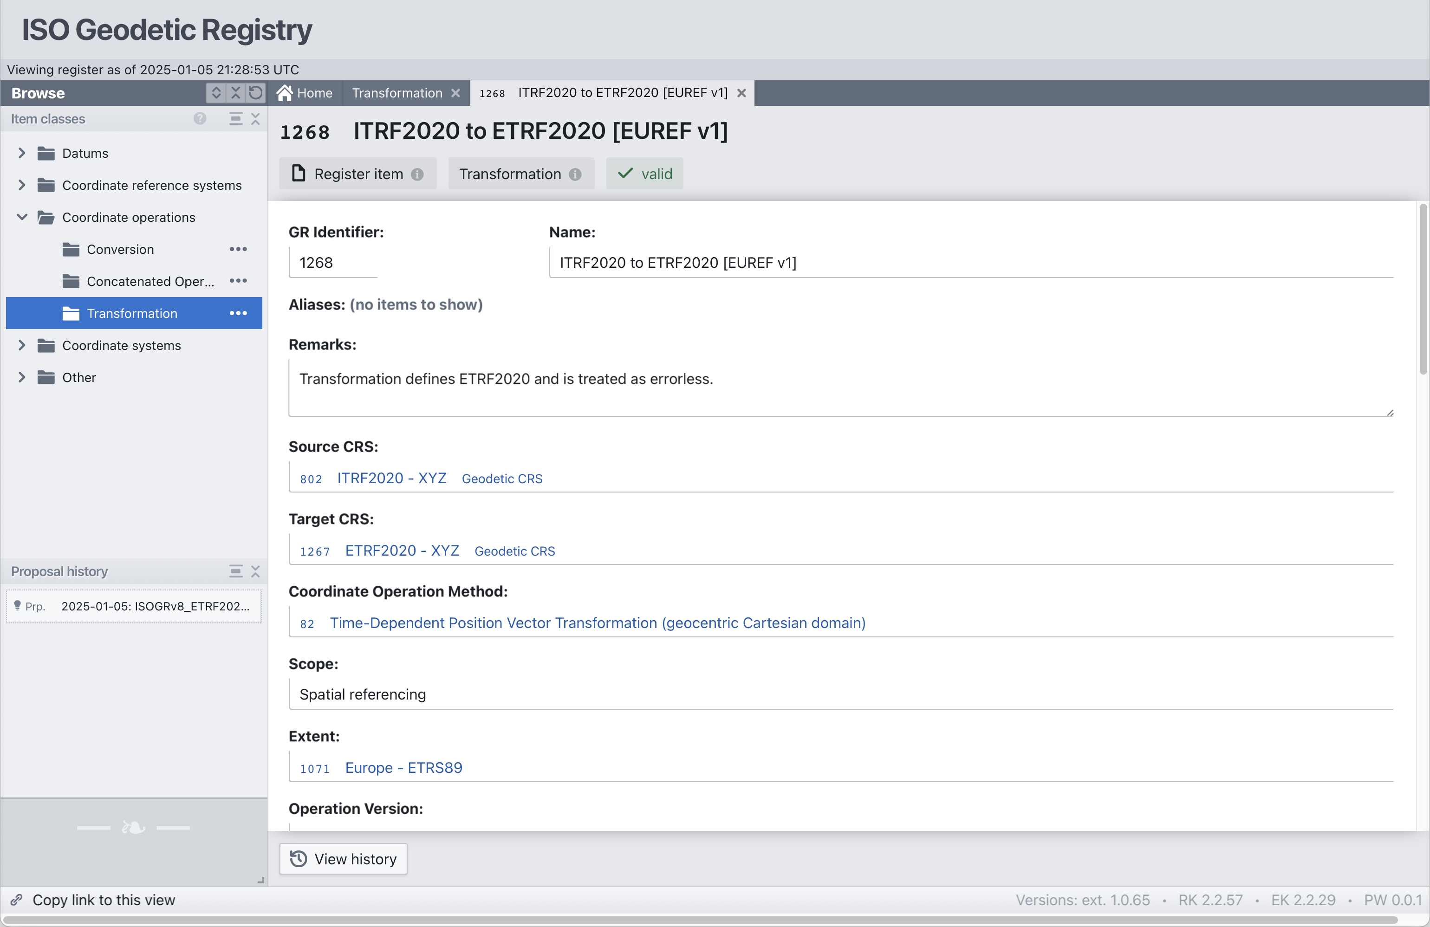

Slide 15
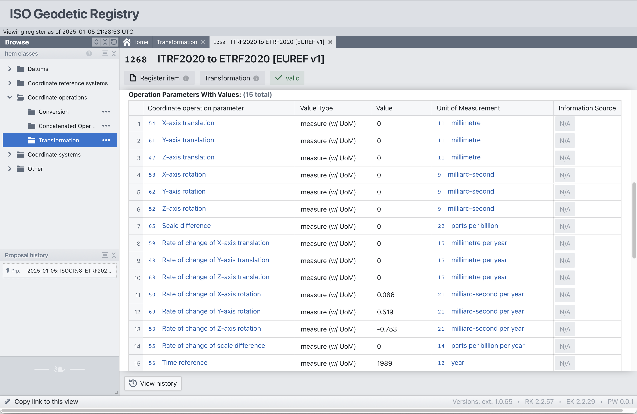

Slide 16
Planned new content
Over a thousand map projections for existing content
Reference frames used by GNSS systems
WGS 84 – GPS (done)
PZ-90 – GLONASS
GTRF – Galileo
CTRF 2000 – BeiDou
JGS2010 – QZSS
National ETRS89 realizations
Swedish SWEREF99 in progress – dynamic datum
EUREF requesting members also add their national realizations
National SIRGAS realizations
Colombia’s MAGNA-SIRGAS 2018 in progress
SIRGAS-Chile realizations beginning

Slide 17
OUTLINE
Introduction
ISO geodetic registry
EPSG geodetic parameter dataset
OGC registry
Summary and conclusions

Slide 18

https://epsg.org/
EPSG registry
European Petroleum Survey Group (EPSG)
Online registry
Holds data, has a graphic user interface (GUI) and an application programming interface (API)
Data is stored in a data model which implements ISO 19111
EPSG Database
EPSG Geodetic Parameter Dataset – the data in the EPSG registry
The Dataset contains definitions of coordinate reference systems and coordinate transformations which may be global, regional, national or local
One of the Dataset export options, MS Access used as carrier
Dataset export also available as MySQL, Oracle or PostgreSQL scripts
The Dataset is maintained by the Geodesy Subcommittee of the IOGP Geomatics Committee

Slide 19
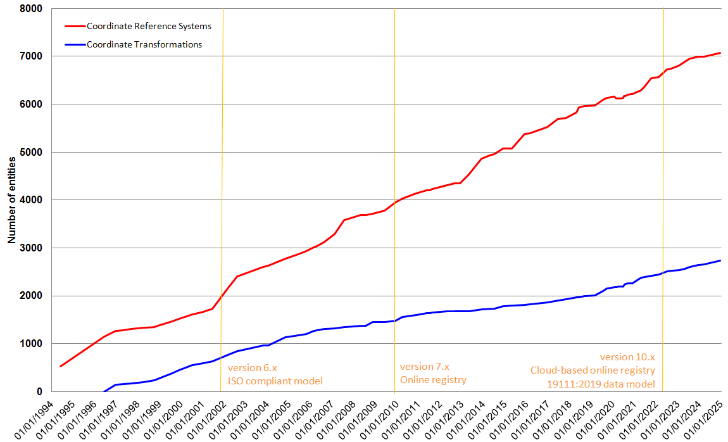
EPSG content growth

Slide 20
What are the EPSG codes?
Each data record has a permanent code, i.e., an integer identifier
EPSG code ranges from 1024 to 32766
Data is never deleted from the EPSG Dataset, although minor corrections may be made (no code change)
Anything with significant error will be deprecated and replaced with a new record with a new code. The deprecated record remains in the Dataset
EPSG codes are unique within each table (record type) of the data model
But the same code value may be used in different tables
Exception: codes are unique across union of CRS and coordinate operation tables **
To be unique, EPSG code and table (or entity type) should be cited as
For example, “EPSG extent 1234” (= ‘Tonga – onshore and offshore’).
“EPSG transformation 1234” (= a transformation applying to Uruguay).
Code 1234 is also used in two other tables, datum and scope.
No CRS has EPSG code1234, because it is used as a transformation (see ** above)

Slide 21
Purpose of the EPSG codes
Within the relational data model, they are used as a link to ‘component’ records in other tables
For example, the GRS 1980 ellipsoid has a code: 7019, which is used to associate this ellipsoid with many reference frames
Codes for these ‘component’ entities are primarily of use within the EPSG Dataset – they are not usually required by users
Citation of identifier for ‘top level’ entities [CRSs and coordinate operations]
Datasets associated with the same EPSG code can be merged without coordinate conversion or coordinate transformation.
Using EPSG codes in this way is of special interest to data users
to merge their datasets, they do not need the geodetic detail
nor do they need the codes of the component entities (unit, ellipsoid, coordinate system, datum/reference frame, etc).
To merge spatial datasets associated with different CRS codes requires conversion or transformation.
In this context, the code can be used to obtain from the EPSG Dataset the information necessary for the conversion or transformation.

Slide 22
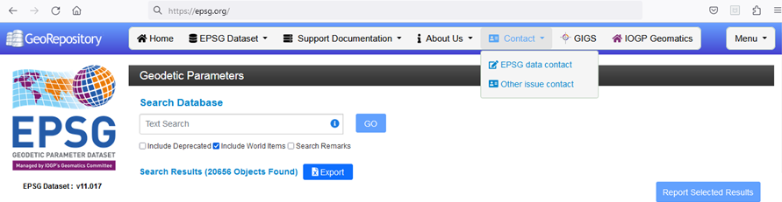
Population of the EPSG Dataset – submitting requests
IOGP do not actively look for data – they react to requests
Requests can be made by anyone – see https://epsg.org/dataset-change-requests.html and https://epsg.org/guidance-notes.html

Slide 23
Population of the EPSG Dataset – submitting requests
Procedure for accepting requests described in https://drive.tiny.cloud/1/4m326iu12oa8re9cjiadxonharclteqb4mumfxj71zsttwkx/736fcb2b-4b6e-4da7-b3ec-a00bc482d190 (EPSG Guidance Note 7-6)
Data must be in public use.
Information about the data must be in the public domain.
Parameters are included in the EPSG Dataset
Grid data files are cited by name, but the grid file itself is not in the EPSG Dataset (or held by IOGP)
Data embedded in applications but not otherwise available is not included
So, if you feel that some data is missing, submit a request ! https://epsg.org/dataset-change-requests.html

Slide 24
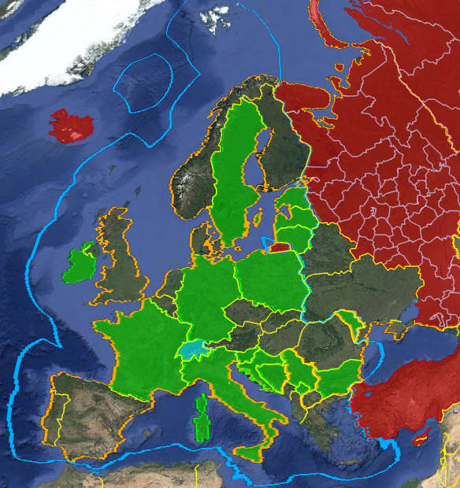
European data in the EPSG Dataset
(as of October 2024)
‘non-ETRS’ national geodetic CRSs, projected CRSs and vertical CRSs [ → 100%]
National geoid models [~40% populated, so ~60% missing ☹ ]
Includes EVRF 2000, 2007 and 2019
Transformations from national vertical CRS to EVRF2019 populated for ~55% of national vertical CRSs [~45% missing ☹ ]
Includes ETRF89 … 2020
Geodetic CRSs XYZ, φλh, and φλ – no projected CRSs
Time-dependent transformations from ITRS taken from Memo and EUREF TN1

Slide 25
European data in the EPSG Dataset
(as of October 2024)
National realizations of ETRS89 (densifications of ETRF)
Included when given local name (green on map) [~50% of national realizations]
Projected CRSs (UTM and national) based on these national realizations
Missing when national documentation uses ‘EUREF’ or INSPIRE name ‘ETRS89’ ☹ e.g., Norway, Netherlands, Spain, etc. (unshaded on map)
Includes ETRS89 CRSs – based on datum ensemble
UTM – E,N and N,E
National projections for countries with missing national realization, e.g. Norway NTM zones
LCC and LAEA (extent extended to include Azores, Madeira, Canaries, Iceland, Cypress, Turkey)
EUREF members can help with missing data ! ☺

Slide 26
Other IOGP resources supporting geodesy
Geomatics Committee
Technical reports and operational guidelines
Data models
Data exchange formats
More information at https://www.iogp.org/workstreams/engineering/geomatics/
Geodesy Subcommittee
Geodesy Guidance Notes
More information at https://www.iogp.org/workstreams/engineering/geomatics/geodesy/
Dynamic coordinate reference system video https://youtu.be/IKM-bR6SwVs
GIGS open-source data driven testing framework https://gigs.iogp.org/
Evaluate software application capability
The objective of GIGS testing is to identify elements of software functionality that could result in failures of geospatial integrity.

Slide 27
OUTLINE
Introduction
ISO geodetic registry
EPSG geodetic parameter dataset
OGC registry
Summary and conclusions

Slide 28

https://www.ogc.org/
OGC registry
The OGC standards help to ensure interoperability and seamless exchange of geospatial information across different systems and platforms
OGC registry provides a machine-readable interface and serves as a Uniform Resource Identifier (URI) resolver for entries in the European Petroleum Survey Group (EPSG) registry
It is overseen by the OGC Naming Authority
Specific Earth Coordinate Reference System (CRS) content is managed by the CRS Domain Working Group (CRS DWG
Planetary/astronomical CRSs content managed by the Planetary DWG
The displayed material if from the following publication:
Joint ISO/TC 211, OGC, IOGP. (2022). Guide to Coordinate Reference System (CRS) Resources, https://committee.iso.org/files/live/sites/tc211/files/Resources/GuideToCRSRegistries3.pdf. Accessed 3 February 2025.

Slide 29
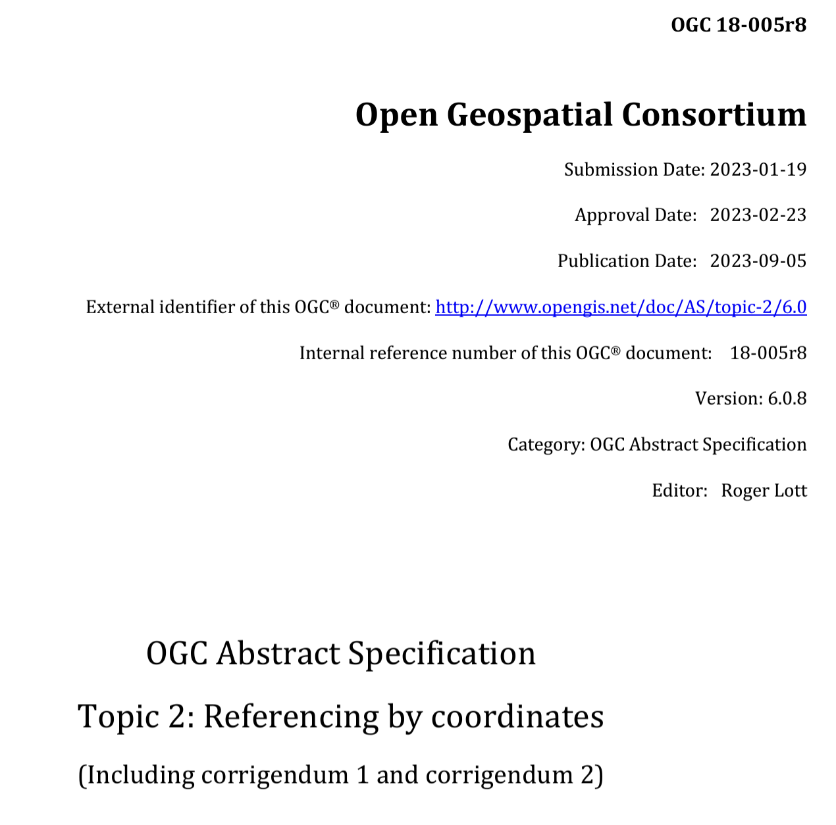
Also published as ISO 19111:2019
The foundation upon which all coordinate reference information is built in OGC and ISO / TC 211

Slide 30
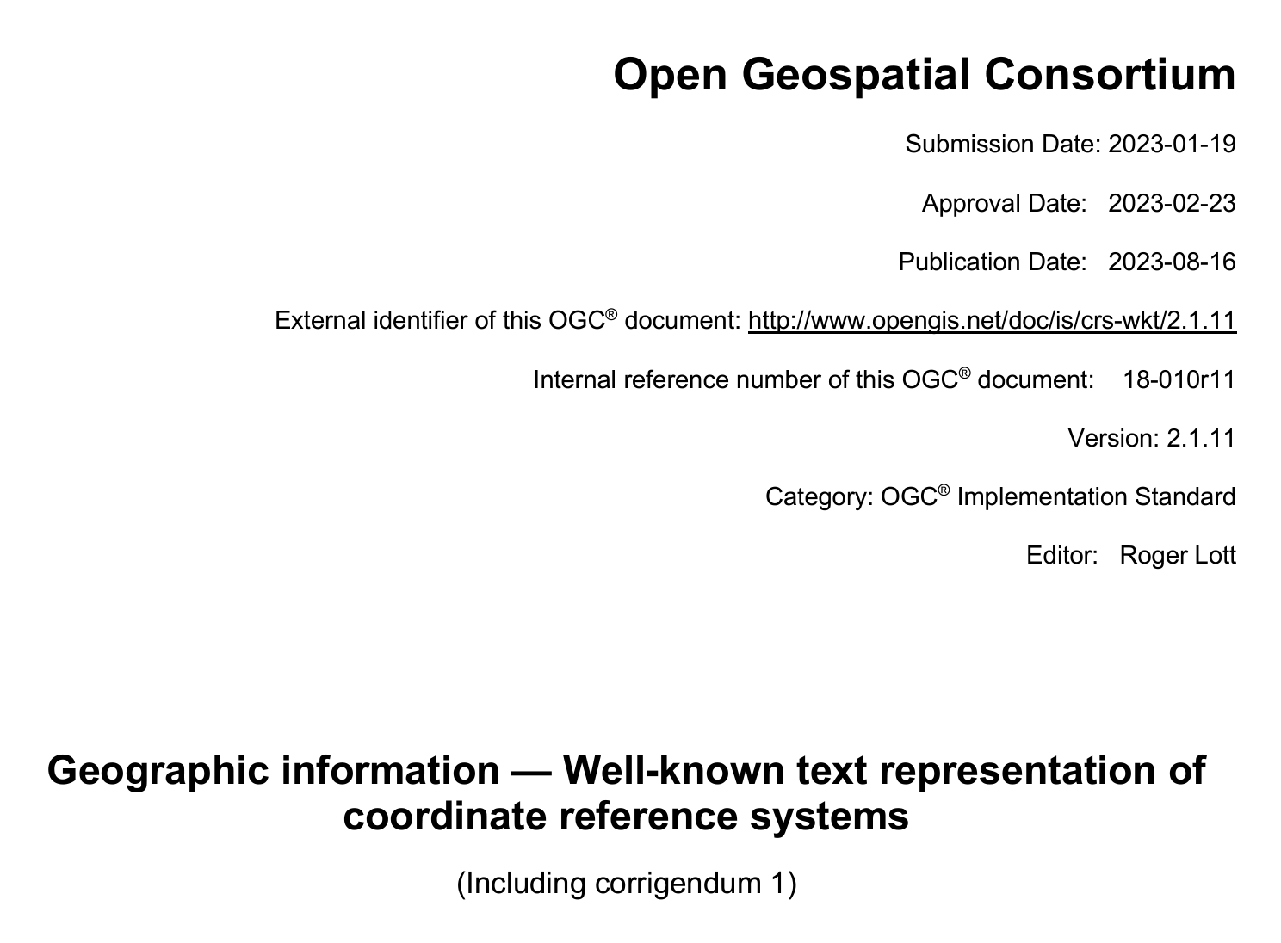
The CRS representation model for all OGC Standards

Slide 31
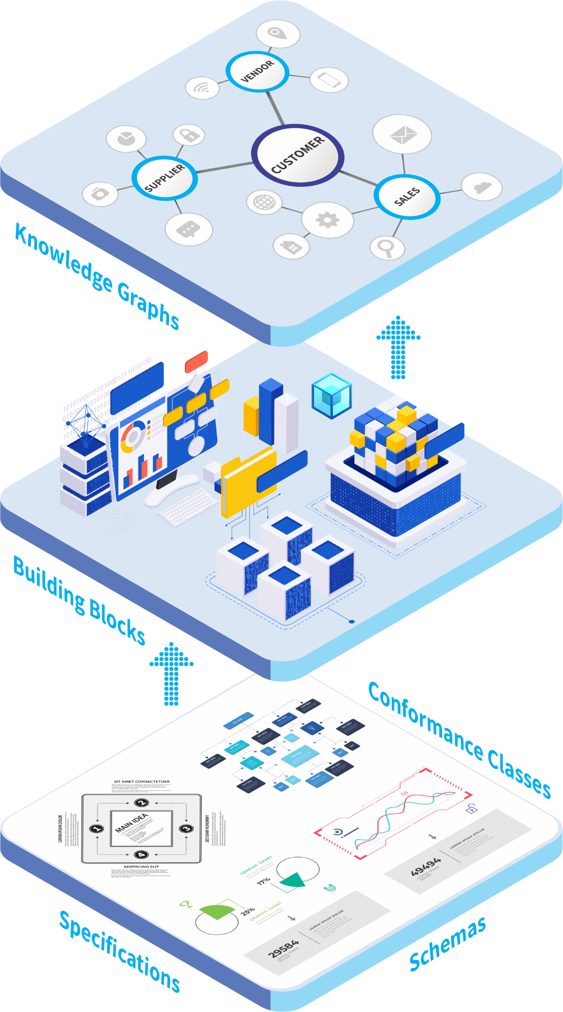
OGC Registry for Accessible Identifiers of Names and Basic Ontologies for the Web (RAINBOW), https://defs.opengis.net/vocprez/
OCS RAINBOW is
An initiative by the OGC
“Knowledge Graph”
Concepts and Specifications
OGC schema repository specifies the order, types and labels of information that describe geospatial datasets, https://schemas.opengis.net/
Glossary of terms promote the use of common terminology, https://defs.opengis.net/vocprez/object?uri=http%3A//www.opengis.net/def/glossary
Notes:
Imagine a scenario where multiple organizations are working together on a disaster response effort, such as coordinating relief efforts after a major earthquake. These organizations might include government agencies, non-profits, and international aid groups, each using different geospatial data systems and formats.
Without a tool like the OGC Rainbow, integrating and sharing this data could be challenging due to differences in terminology, data structures, and formats. This could lead to delays and inefficiencies in the response effort.
However, with the OGC Rainbow, these organizations can easily access a centralized platform that standardizes geospatial data concepts and vocabularies. This ensures that all parties are using consistent and interoperable data, facilitating seamless communication and coordination. As a result, relief efforts can be more efficient and effective, ultimately saving lives and resources.
In summary, the OGC Rainbow enhances interoperability, making it easier for diverse organizations to collaborate and respond to global challenges more effectively.

Slide 32
OGC RAINBOW
Serves
As a web-accessible source of information about concepts and vocabularies defined either by OGC or hosted on behalf of other communities
Applies
FAIR (Findability, Accessibility, Interoperability, and Reusability) principles through a structured way of accessing and using geospatial data effectively
Provides
Links between OGC and related domains
Hosting for key resources from liaisons

Slide 33



Why OGC RAINBOW?
“Normalizes” access to many types of resources
As a web-accessible source of information about concepts
Supports better design
Convergence
Transparency of dependencies
Consistency
The alternative is
Chaotic
Hard to navigate
Non-machine-readable
Unsustainable
Copy. Paste. Modify.
Invent your own.
Link. Profile. Reuse.

Slide 34
Where?
GitHub repositories
Local autonomy over content and process
Knowledge Graph(s)
Online registries of content using common format
Linking back to authoritative content
Web UI
Navigation (Linked Data)
Search, integration into other Web Resources
BuildingBlock Registries
Richer UI bundling different types of resources in context of testing, playground and other development resources.

Slide 35
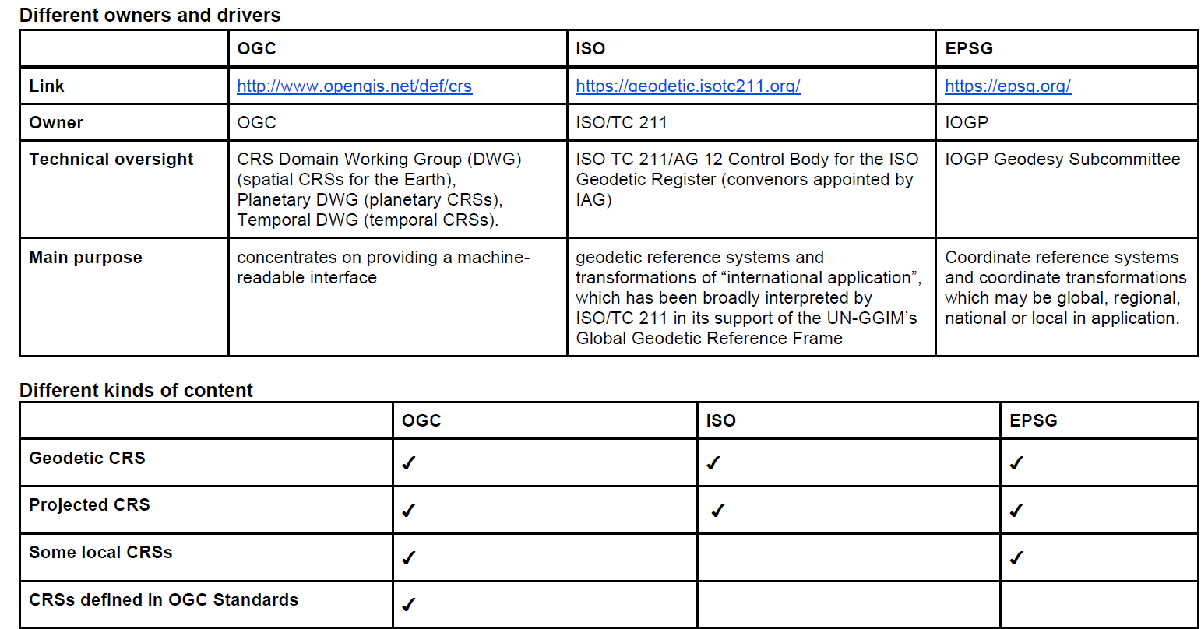
Summary
The geodetic registries do not compete, they complement each other
Geodetic data developers must adhere to generally accepted standards and practices to be able to add datasets to registries
The geodetic registry organizations welcome your contributions
The displayed material if from the following publication:
Joint ISO/TC 211, OGC, IOGP. (2022). Guide to Coordinate Reference System (CRS) Resources, https://committee.iso.org/files/live/sites/tc211/files/Resources/GuideToCRSRegistries3.pdf. Accessed 3 February 2025.

Slide 36
Q & A

